Slide 1
Amazon Analysis
Dylan Ledanois
Thomas Sadurni
Ernest Timkin
Paulien Torrekens

Slide 2
Presentation of the Data
Analysed Asset: Amazon Stock in relation to its benchmark S&P 500 INDEX
Period: 11 years (from 01/02/2011 till 01/03/2022)
Data used :
S&P 500 Values (adjusted close from Yahoo Finance Database extracted through Python)
Returns on S&P 500 (calculated with a formula (P1 - P0)/P0, where P1 is the price of the current period, P0 is the price of the previous period)
Amazon Prices (adjusted close from Yahoo Finance Database extracted through Python)
Returns on Amazon (calculated with a formula (P1 - P0)/P0 )
Monthly TB (calculated by using 3-month US Treasury Bills extracted through python and dividing them by 100 in order to have decimals)
Excess Returns on S&P 500 (calculated with a formula Returns on S&P 500 - Monthly TB)
Excess Returns on Amazon (calculated with a formula Returns on Amazon - Monthly TB)
SMB and HML (the factors of French-Fama model are taken from the website given by the professor: https://mba.tuck.dartmouth.edu/pages/faculty/ken.french/data_library.html . There is no data for the last 2 periods 01/02/22 and 01/03/22, however, we assume that it will not affect the results significantly. )
Residuals are taken from the regression analysis (simple CAPM model)

Slide 3
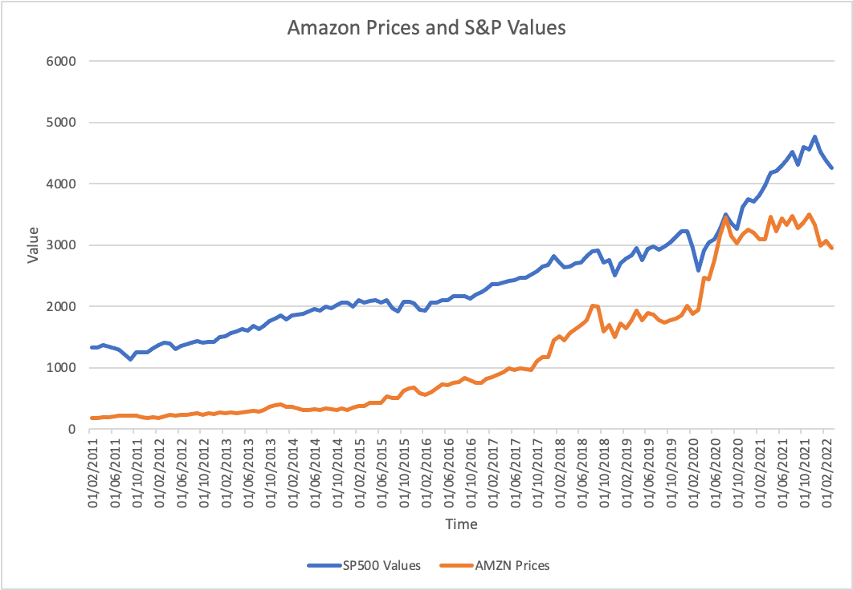
Plot of Amazon Prices and S&P 500 Values
Comment:
Both Amazon Prices and S&P 500 Values have been growing consistently from the start of the period till the end.
There were some sharp ups and downs for both of them. However, S&P 500 seems to have smoother growth than Amazon.

Slide 4
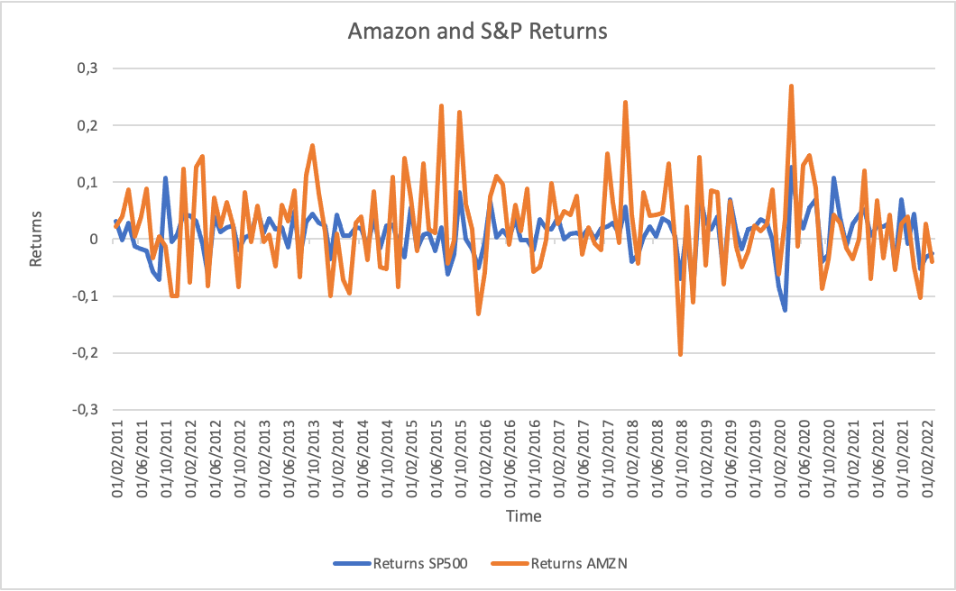
Plot of Amazon and S&P 500 Returns
Comment:
On the graph on the left, we notice that Amazon returns are more volatile than the returns of S&P.
Furthermore, we can decide that Amazon has the highest returns but also the highest losses. In addition, we from the graph we can conclude that the returns of S&P 500 is more consistent than the Amazon’s returns and deviate less from 0.

Slide 5
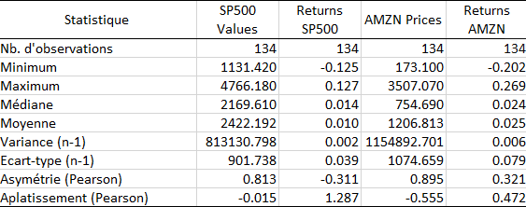
2.1 Descriptive Statistics on the Transformed Data: Kurtosis and Skewness
For our analysis we will focus on the returns and not on the prices.
Skewness: S&P 500 returns have a negative skewness which means that the majority of the series is concentrated on the right of the median and the mean. Amazon’s returns have a positive skewness which means that the mass of the series is concentrated on the left of the median and mean.
Kurtosis: The Kurtosis of S&P 500 and Amazon are below 3, therefore we can conclude that the series of returns of Amazon and S&P are platikurtic.

Slide 6
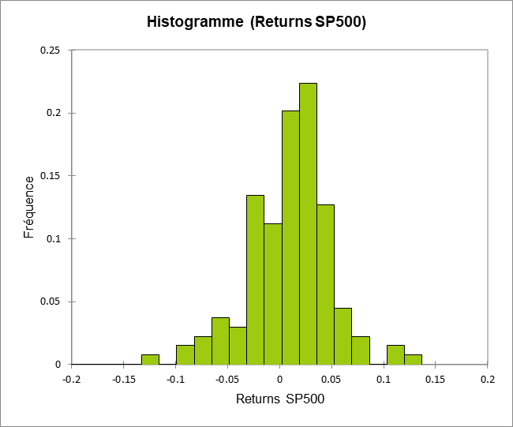
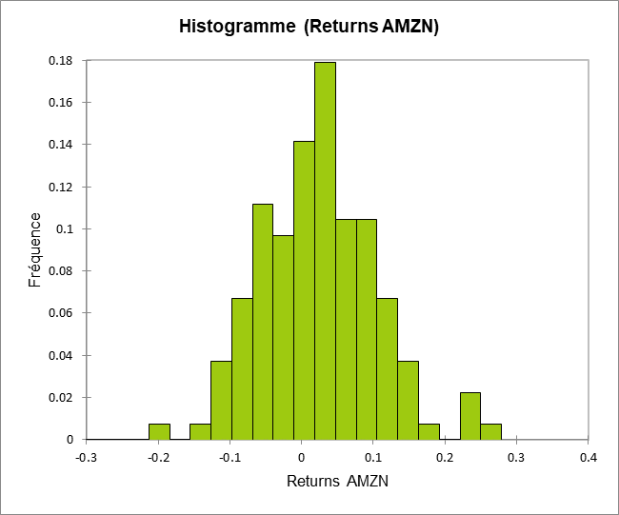
2.2 Descriptive Statistics on the Transformed Data: Histograms

Slide 7
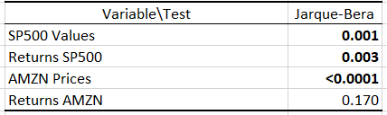
2.3 Descriptive Statistics on the Transformed Data: Normality test
Once more, we focus only on the returns of the stocks.
We can see that the p-values are below alpha (=0.05) for the returns of the S&P 500. So, we reject the null hypothesis and suggest that the S&P 500 returns series are not normally distributed.
For the returns of Amazon, we cannot reject the null hypothesis because p-value is 0.170, which is greater than 0.05. This means that we can suggest that the returns of Amazon stock are normally distributed.

Slide 8
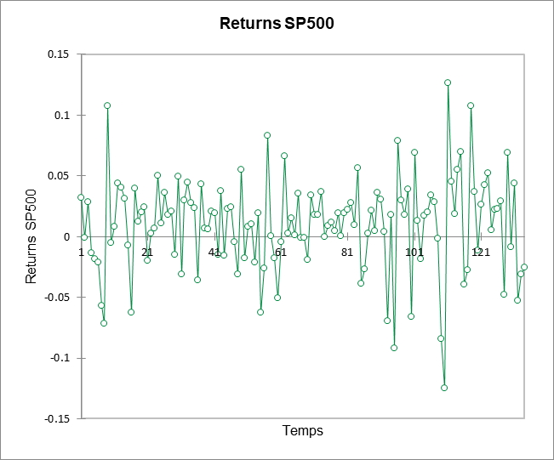
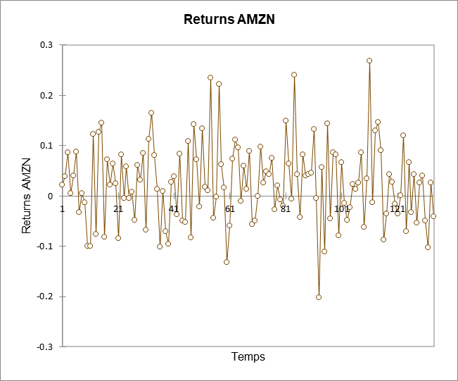
3 Autocorrelation Function:
Stationarity
We observe mean stationary series for both data.

Slide 9
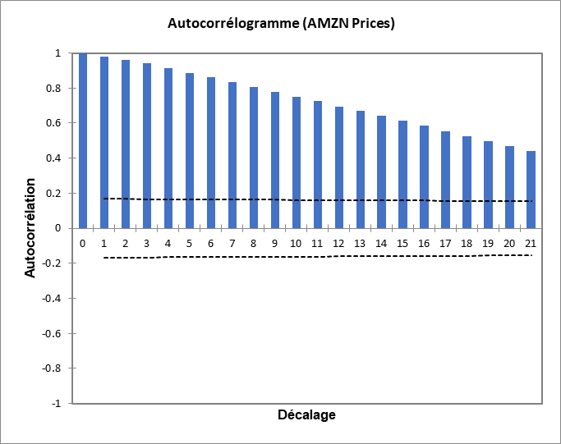
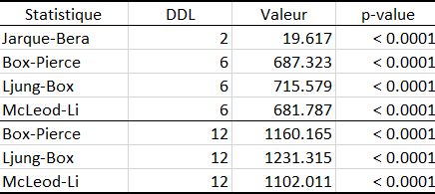
3.1 Autocorrelation Function:
Autocorrelation of Amazon Prices
Test de normalité et bruit blanc (AMZN Prices)
After analysing the table above, we can reject the null hypothesis. This hypothesis states that there is white noise, that the serie is normally distributed, and that the tests are all highly significant.
From the figure above, we can conclude that all autocorrelations are outside the confidence interval. Further we see that they are very high and don't drop rapidly, so we conclude that there is no stationary.

Slide 10
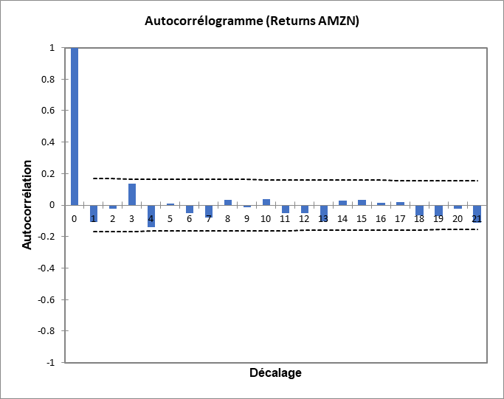
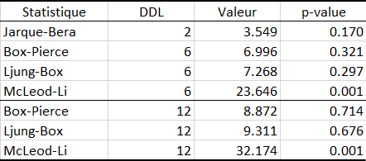
3.2 Autocorrelation Function:
Autocorrelation of Amazon returns
Test de normalité et bruit blanc (AMZN Prices)
From the table above we can reject both null hypothesis because p-value < alpha (0.05).
Hence, we can conclude that there is a normal distribution and white noise in the series.
On the figure we see that the autocorrelation is located in the confidence interval and it drops drastically. Therefore, we can then conclude that there is stationarity.

Slide 11
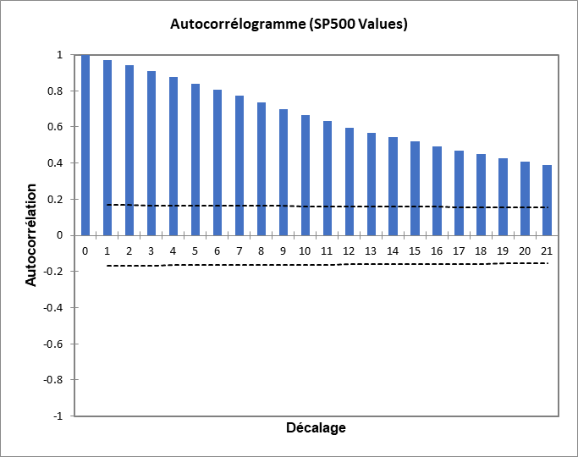
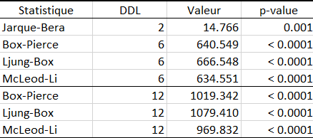
3.3 Autocorrelation Function:
Autocorrelation of S&P500 Values
Test de normalité et bruit blanc (SP500 Values)
On this graph, we see the same trends as with the Amazon Prices. So, we will also reject the null hypothesis, which states that there is white noise and that the serie is normally distributed.
The graph shows us that all autocorrelations are outside the confidence interval. They are very high and don't drop rapidly, so we conclude that there is no stationary.

Slide 12
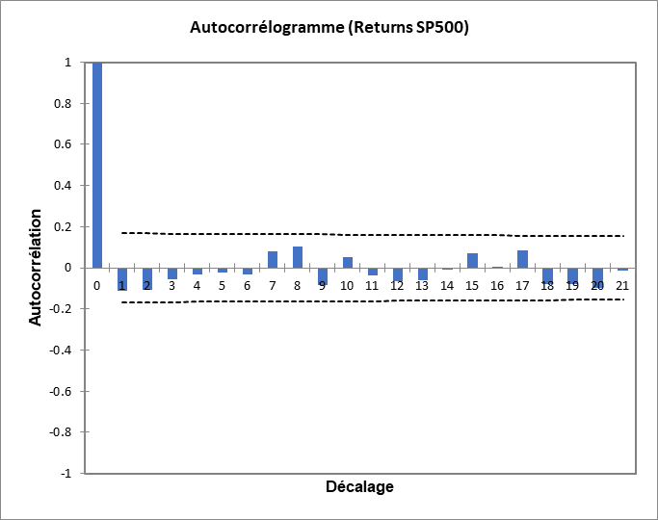
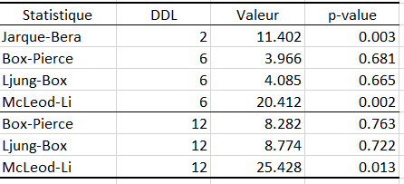
3.4 Autocorrelation Function:
Autocorrelation of S&P500 Returns
Test de normalité et bruit blanc (SP500 Returns)
With this table, we reject the hypothesis, we can then suggest that the serie is not normally distributed. However, we do not reject this hypothesis, so we can say that there is the presence of white noise.
Here the autocorrelation is located in the confidence interval, and it drops drastically, we can then conclude that there is stationarity for the S&P returns.

Slide 13
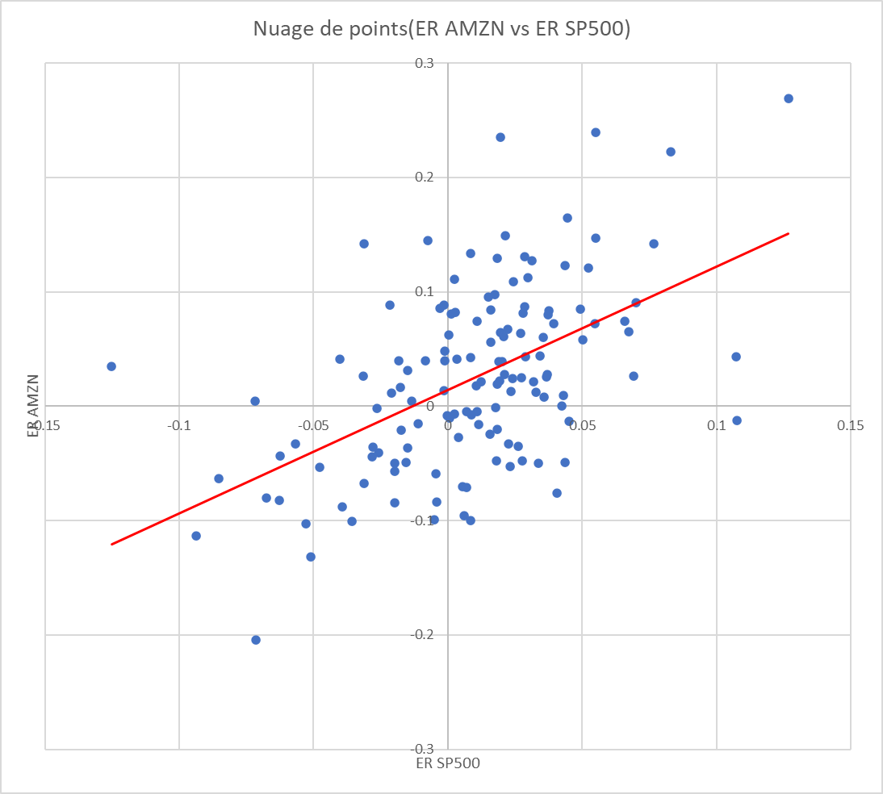
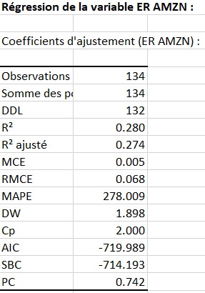
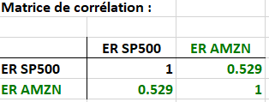
4 CAPM Model
The equation of the model will be the following : ER[AMZN] = α + β*ER[S&P] + err
This corresponds to a reasonable correlation.
R² means that our model is good but not perfect. It is acceptable, but the closest it is to 1 the better it is.

Slide 14
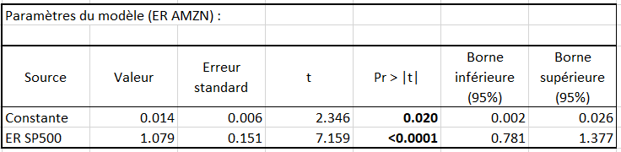
4.1 CAPM Model:
Regression
The estimated model is the following :
ER AMZN = 0.014094450840893 + 1.07877252537154 * ER SP500
H0 : alpha = 0
p-value < 5%
H0 : beta= 0
p-value < 5%
We reject the null hypothesis, so we conclude that alpha is statistically significant and beta is highly statistically significant

Slide 15
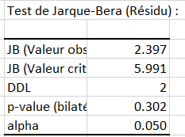
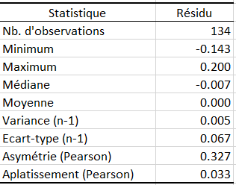
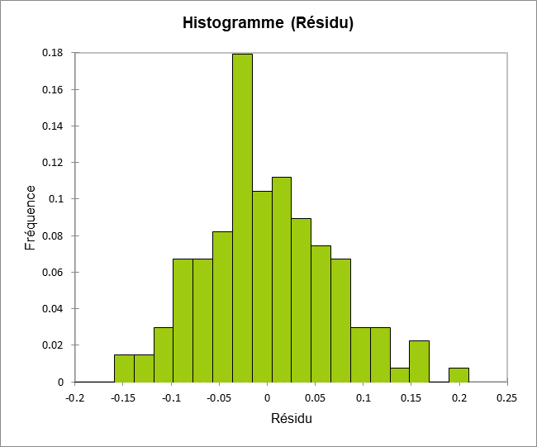
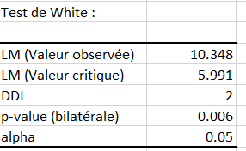
4.2 CAPM Model:
Residuals
For the Jarque-Bera test, we can't reject the hypothesis, so we do not need dummies and we can assume that the serie does not follow a normal distribution.
Positive Skewness, which means that the majority of the residuals are concentrated on the left of the median and the mean.
Kurtosis is almost 0, so we could think that our serie can follow a normal distribution.
For the White test, p<alpha, so we reject the null hypothesis, and accept the fact that residuals are heteroscedastics.

Slide 16
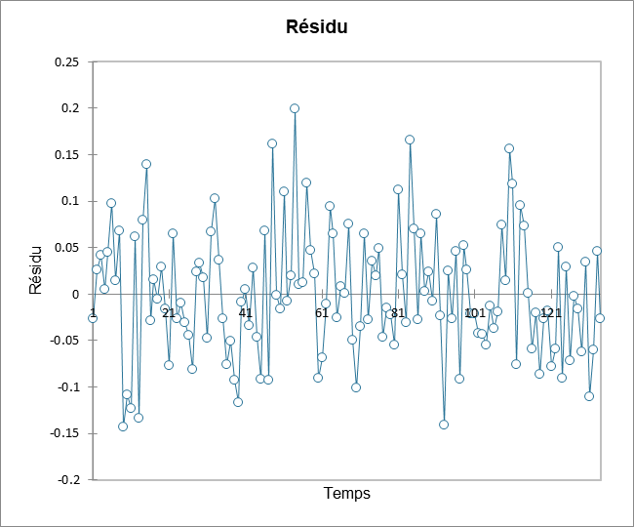
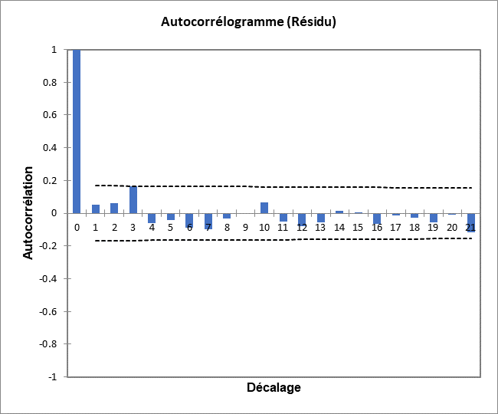
4.3 CAPM Model:
Residuals and stationarity
From this graph we can conclude that there are mean stationarity of the residuals.
Here again the autocorrelation is located in the confidence interval and it drops drastically, we can then conclude that there is stationarity for the residuals. With a Durbin Watson test, cannot reject the null hypothesis, so we can say that the residuals are not autocorrelated, which is what we want to have.

Slide 17
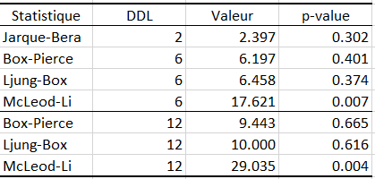
4.4 CAPM Model:
Residuals and normality test
Test de normalité et bruit blanc (Residuals)
Since p-values > alpha, we cannot reject both hypothesis. Therefore, we can conclude that the series is normally distributed with white noise.
With all the previous tests we have executed, we can validate our model.

Slide 18
5. Extension to Multiple Regression
We decided to run a 3 factor Fama-French Model by extending the CAPM with SMB (small minus big) and HML (high minus low).
The estimated model is the following:
ER AMZN = 0.011398059072037 + 1.18507467265356 * ERSP500 - 0.199088765387173 * SMB - 0.88838118668951 * HML ,
Where
ER AMZN is expected return on Amazon Stock
ERSP500 is expected return on S&P 500 INDEX.
ERSP500, SMB and HML are explanatory variables. The numbers that come before them are their Betas. The first number in the equation (0.01139…) represent the alpha of the model.

Slide 19
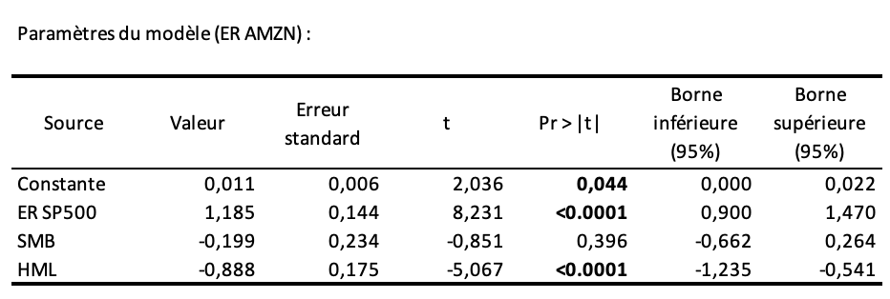
Model Results and Statistical Significance
The alpha is equal to 0,011. Since T-statistic with 95% interval is higher than 2 and the p-value (probability) is lower than 5% (0,05), we can reject the null hypothesis (H0) and conclude that alpha result is statistically significant.
The Beta of ERSP500 is equal to 1,185. T-statistic with 95% interval is much higher than 2 and the p-value (probability) is much lower than 5% (0,05), we can reject the null hypothesis (H0) and conclude that beta result of ERSP500 is statistically significant.
The Beta of SMB has a negative sign and is equal to -0,199. T-statistic with 95% interval is lower than 2 and higher than -2, and the p-value (probability) is much higher than 5% (0,05). We cannot reject the null hypothesis (H0), and we can conclude that beta result of SMB is not statistically significant. In other words, for our data, the SMB doesn't have any impact on our dependent variable and we can ignore the SMB in our analysis.
The Beta of HML has a negative sign and is equal to -0,888. T-statistic with 95% interval is much higher than 2 and the p-value (probability) is much lower than 5% (0,05). We can reject the null hypothesis (H0) and conclude that beta result of HML is statistically significant. In other words HML has an important role and impact on dependent variable.

Slide 20
Model Results and Statistical Significance
The sign of HML beta is negative, it means that Amazon stock excess return has a negative relation with the value premium and it behaves more like a growth stock portfolio. The sign of ERSP500 beta is positive, it means that the Amazon stock excess return has a positive relation with the market excess return. Alpha is positive. It means that the stock is outperforming the market. SMB has a negative sign, however, it is not significantly significant that is why we decided to exclude it in the new model.

Slide 21
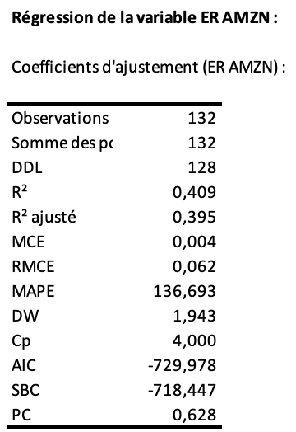
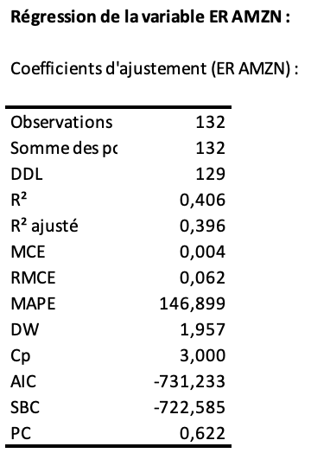
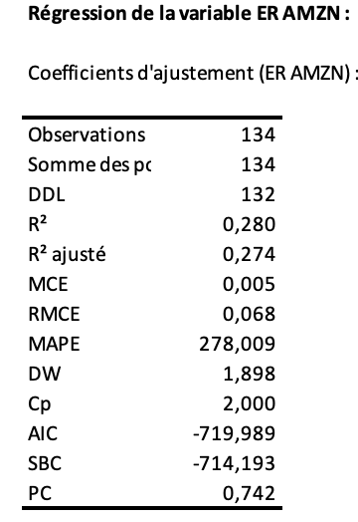
R Squared Values
Comment:
The R squared adjusted shows that our model is good, but it is not perfect. The model is better if it is closer to 1. Since the SMB has no impact and HML has a great impact on the dependent variable, it is logical that R squared adjusted is higher for the CAPM model with HML and without SMB. The original CAPM model is worse than new estimated models. To conclude, the 3 factor Fama-French model without 1 factor such as SMB is the best one among others considered.
SMB and HML
HML
CAPM

Slide 22
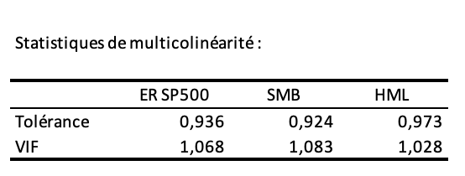
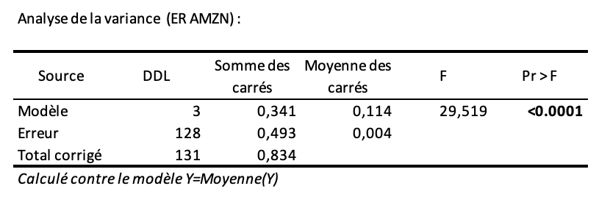
Multicollinearity and F-test
Multicollinearity:
According to the results we can conclude that there is no multicollinearity because VIF is below 10.
F-test:
According to the F-Test, we can reject the null hypothesis. This means that at least one is different from 0, and our model is meaningful.

Slide 23
Amazon Analysis
Thank you for your attention!

